Slide 1


2025 AAMA
House of Delegates Orientation

Slide 2
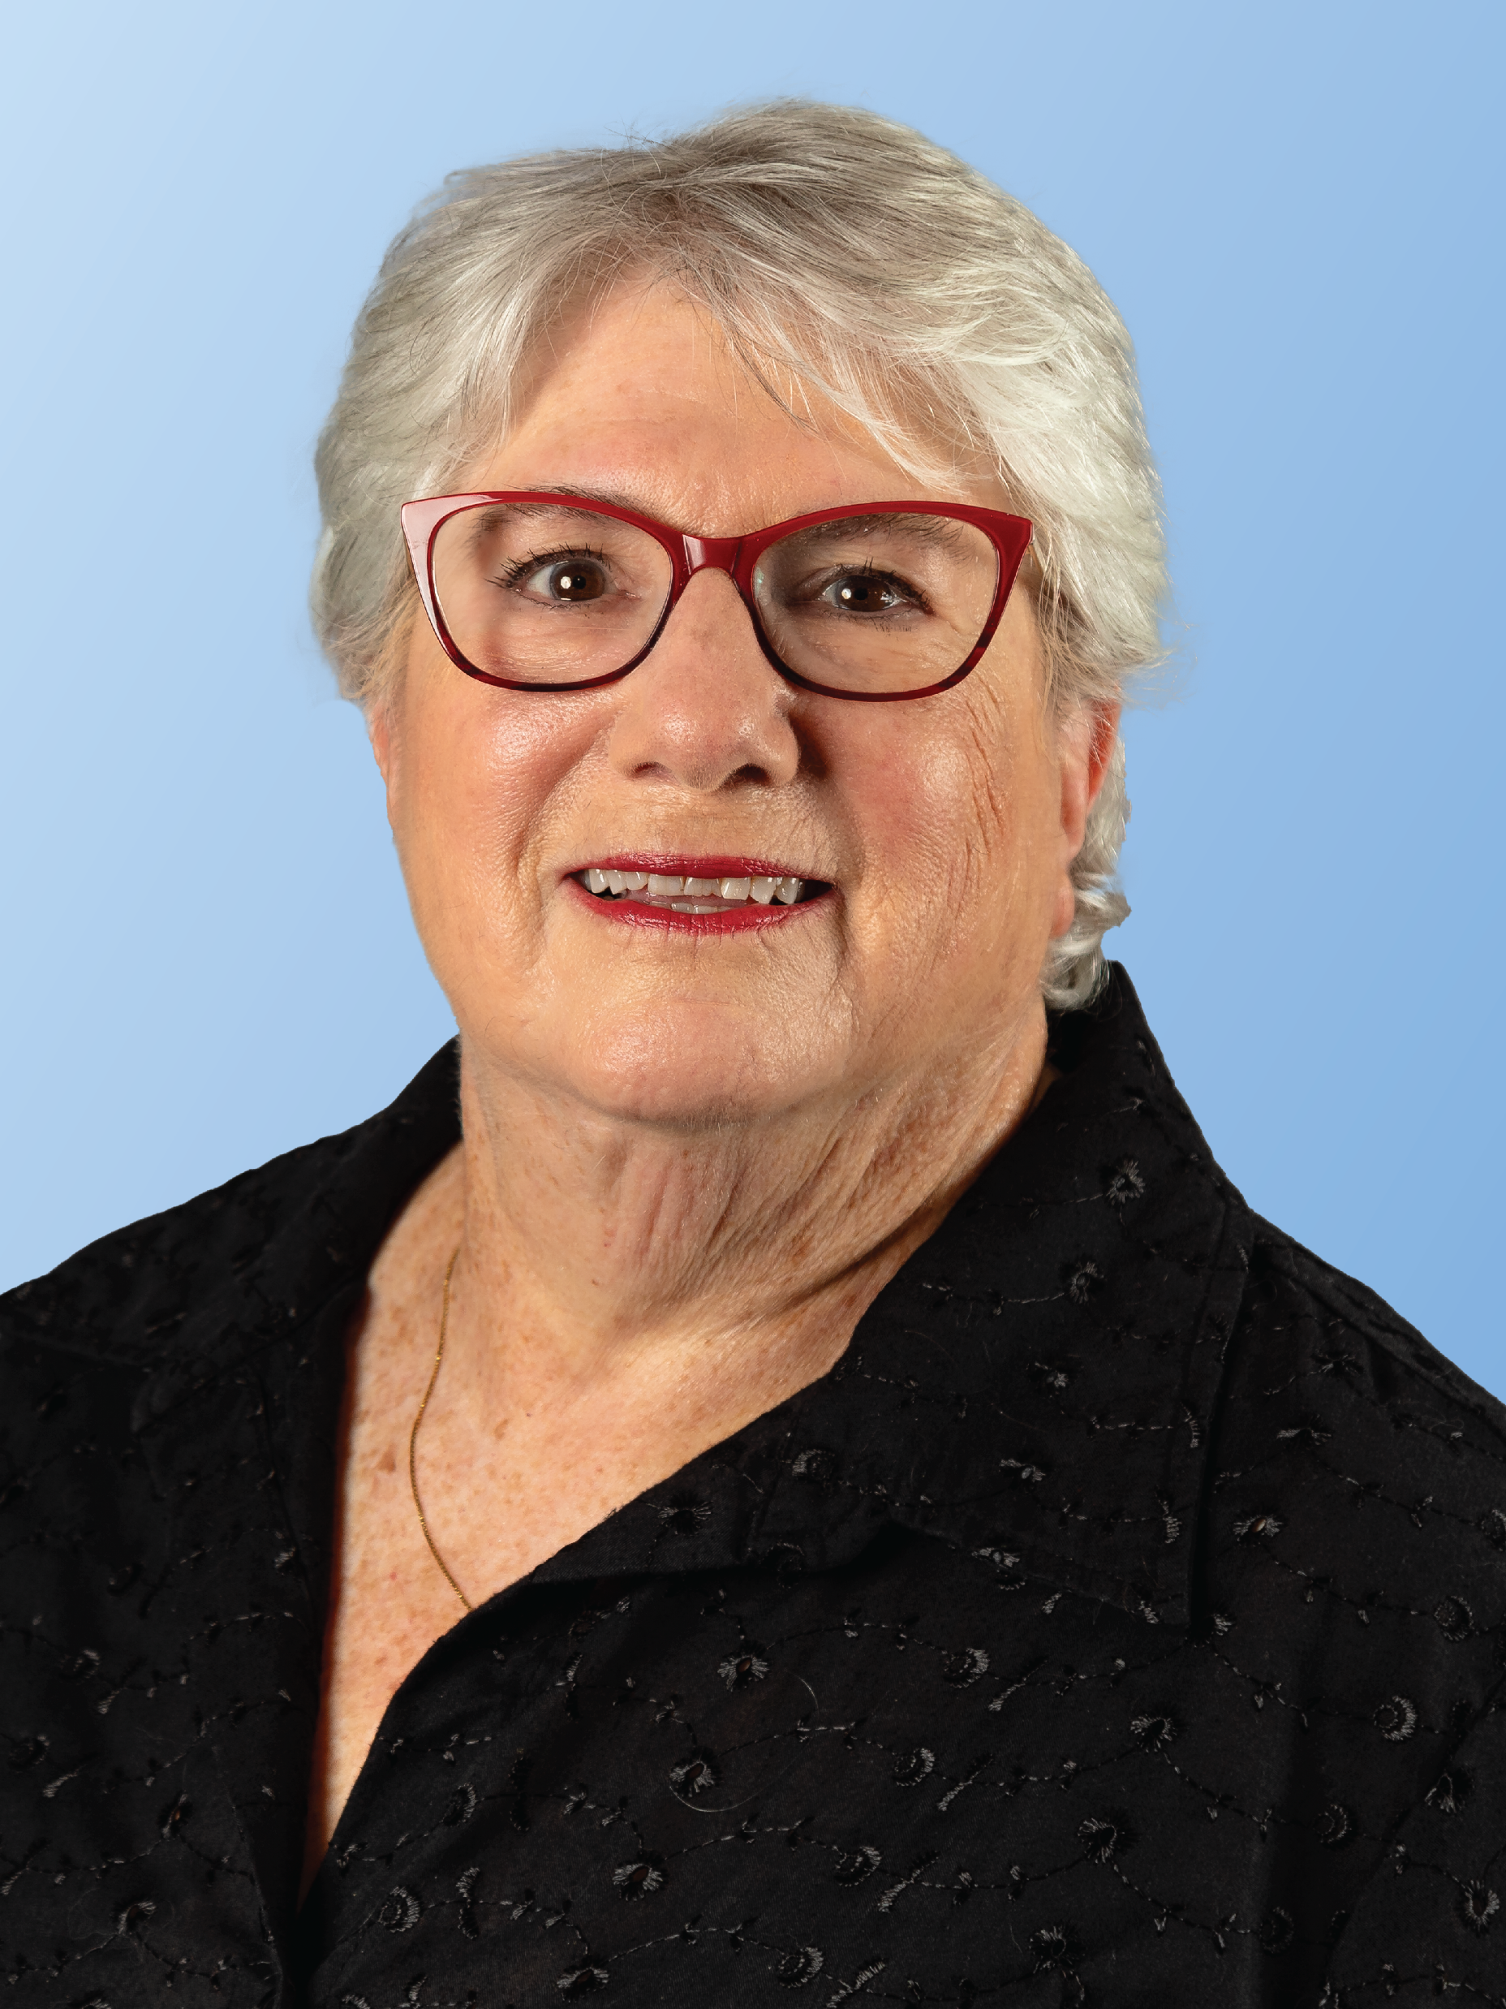
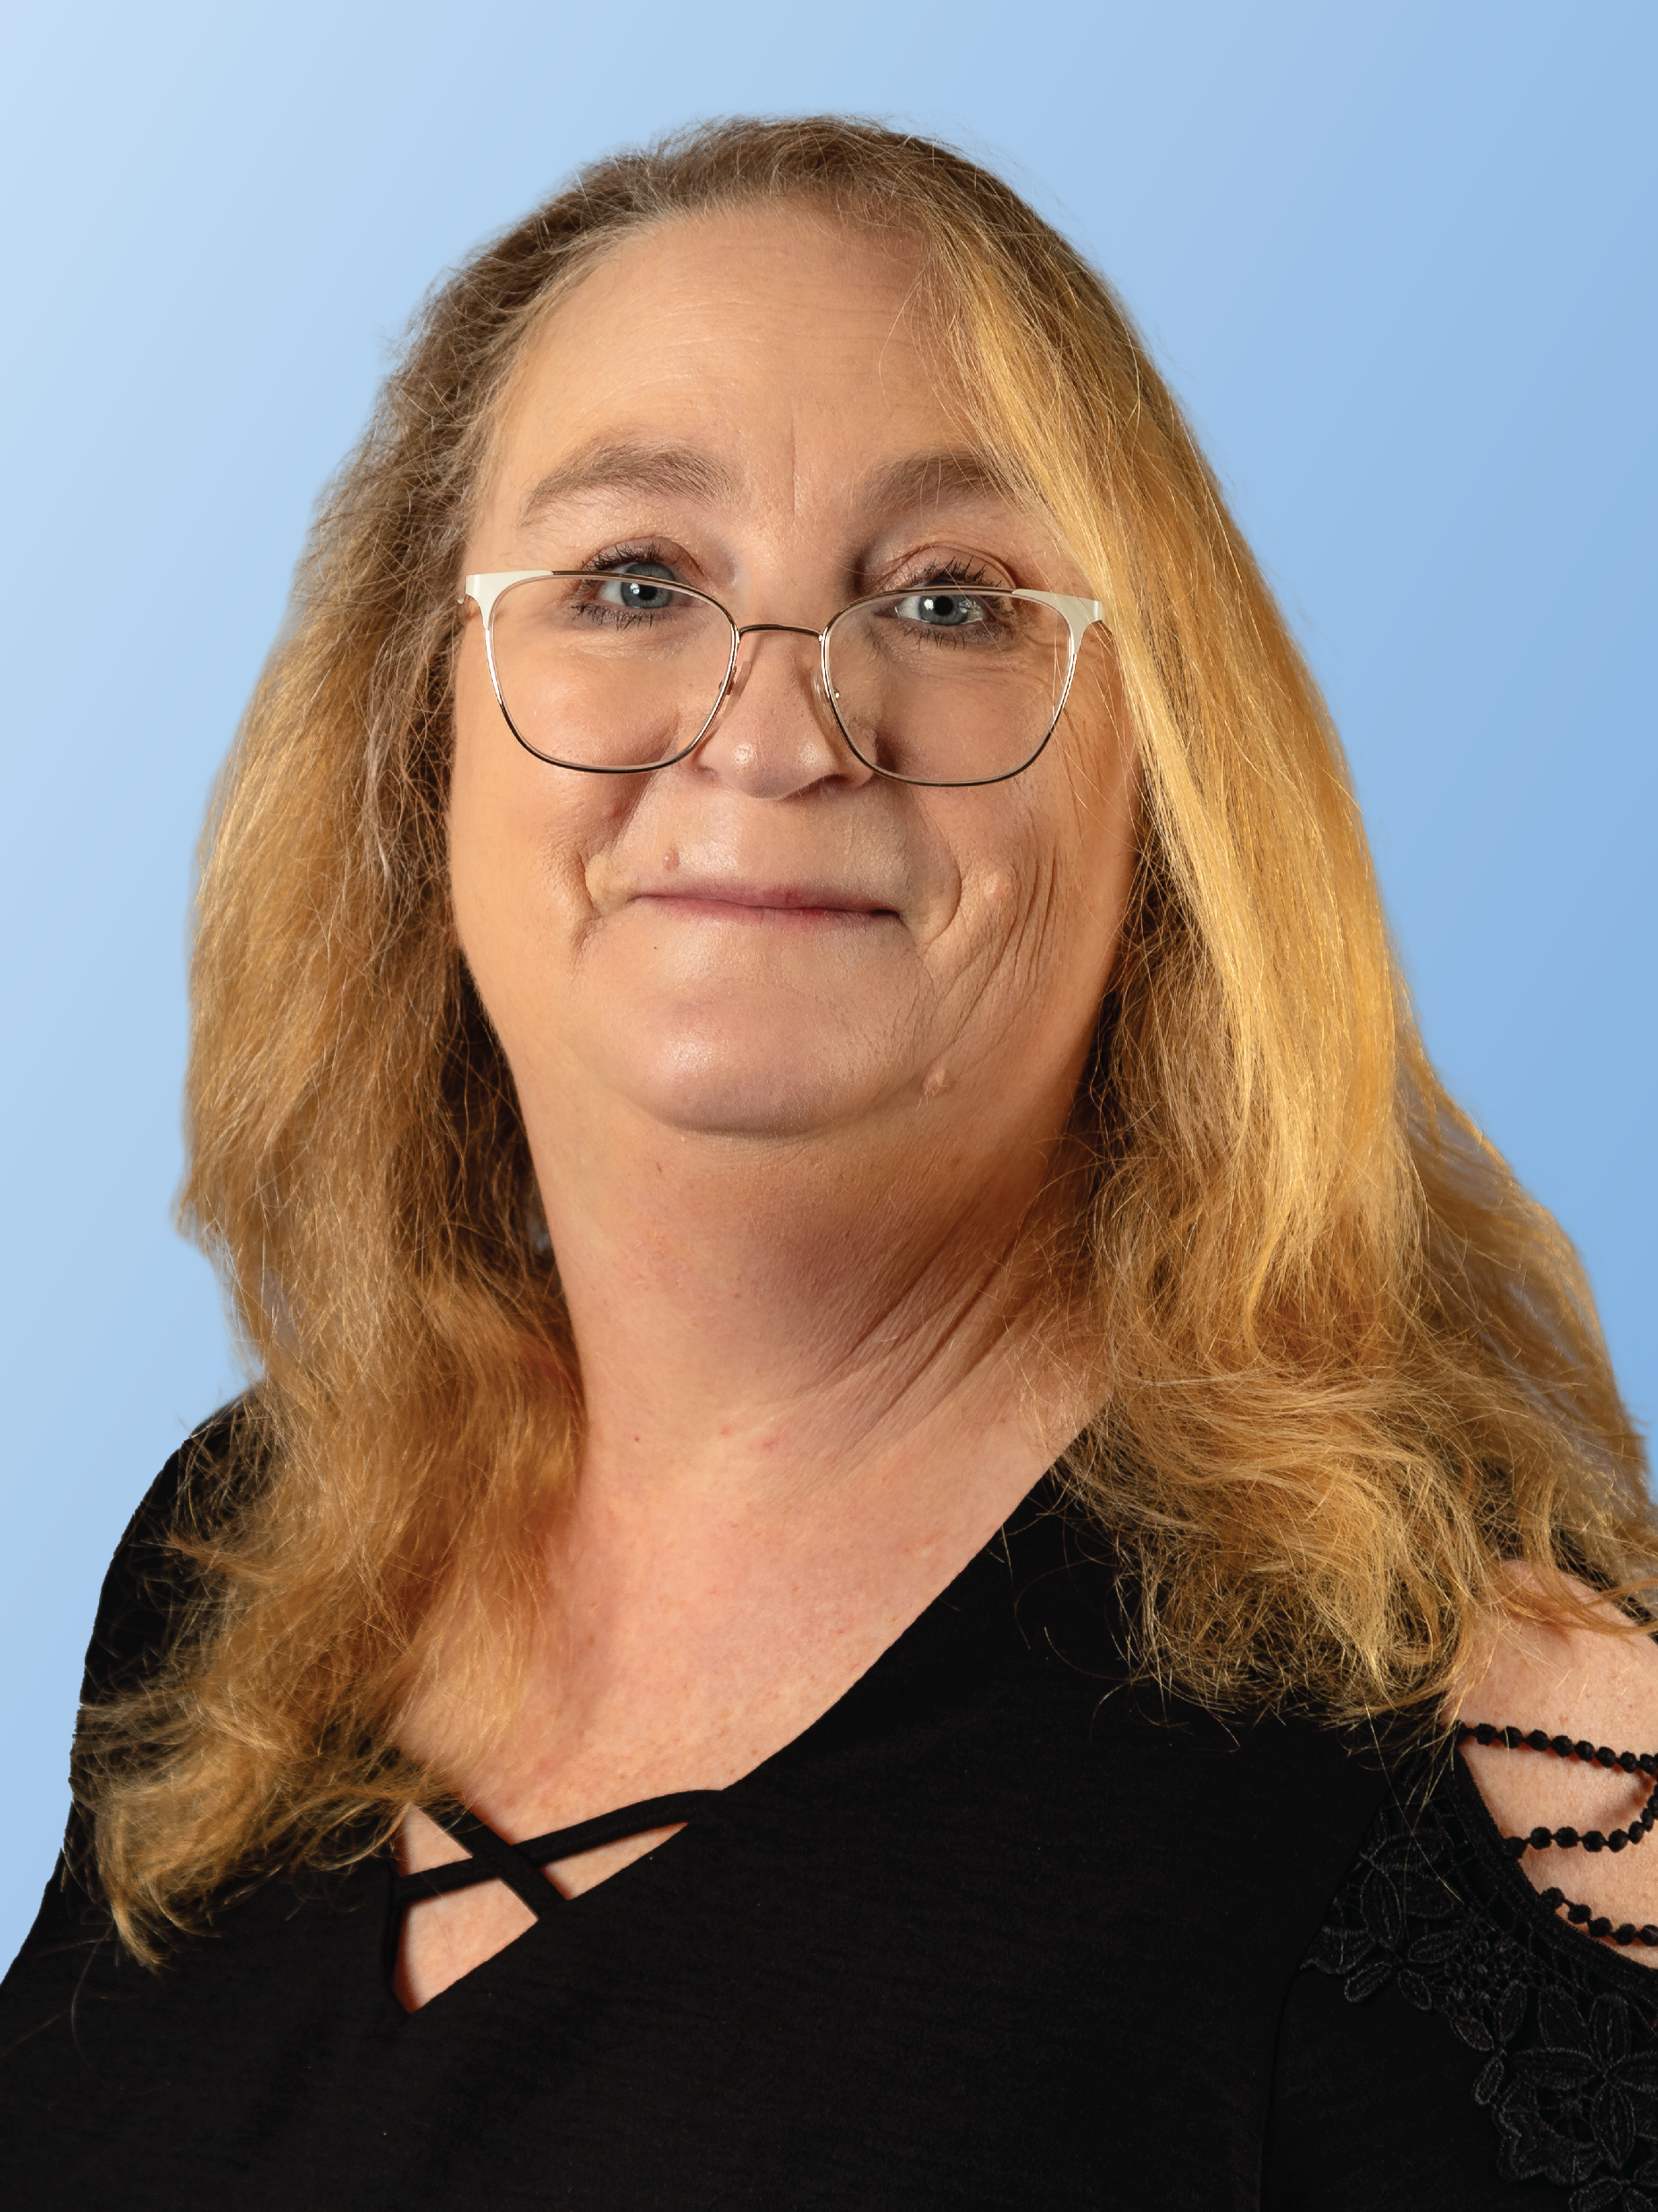

DARK GREY
R: 51 G: 63 B: 76
#333F4C
Jane Seelig, CMA-A (AAMA)
Speaker
Claire Houghton, CMA (AAMA)
Vice Speaker

Slide 3
HOUSE OF DELEGATES PREPARATION
We ask that you arrive in Virginia prepared to serve your society as their representative. Review the Reference Guide for Delegates and Alternates, AAMA Bylaws and Delegates Packet which were emailed to you and are also posted on the AAMA website.
Contact us if you have questions or want to reserve a printed copy for pick up at the conference. It is very important that you limit your use of perfume and do not bring any nut products to the conference to avoid any allergic reactions.
DARK GREY
R: 51 G: 63 B: 76
#333F4C

Slide 4
Credentials Desk Check In
The credentials table will be outside Regency EF Ballroom and Center where the House of Delegates will be conducted.
Friday September 19, 2025 – 3:30 pm – 4:15 pm ONLY Check in if:
  Your state has changes to submitted delegates or alternates
  Your state needs to change a delegate to a proxy vote
  You have a proxy vote to receive your Proxy Card
Saturday September 20, 2025 – 7:15 am- 8:15 am and 5:30 pm-6:15 pm
  Each Delegate and Alternate must check in at the Credentials Desk
  Delegate and alternate ribbons are distributed after check in
  Only enter the room after checking in, prepared not to exit again.
  Arrive no later than 8:00 am so you will be seated in your designated area by 8:15 am
DARK GREY
R: 51 G: 63 B: 76
#333F4C

Slide 5
House of Delegates Session I Saturday , September 20, 2025
Credentials open:
7:15 am-8:15am
HOD from
8:30-10:00 am
Meet the Candidates 10:15-11:45 am
Reference Committee Sessions start at 1:15 pm with Reports, followed by Resolutions then Bylaws
House of Delegates Session II Saturday , September 20, 2025
Credentials open:
5:30 pm-6:15 pm
HOD from
6:30 pm - 10:00 pm
DARK GREY
R: 51 G: 63 B: 76
#333F4C

Slide 6
Credentials Desk Check In
You no longer need to present your AAMA membership card.
Your name badge must be worn and visible.
Check in is by state in alphabetic order.
We ask that each state check in as a group to streamline the check in process.
Delegates and Alternates check in at separate designated areas.
DARK GREY
R: 51 G: 63 B: 76
#333F4C

Slide 7
Credentials Desk Check In
The Credentials table is alphabetized by state, not by Delegate last name.
Proxy cards are issued on Friday except for emergencies.
Present proxy cards at check-in for each house session.
DARK GREY
R: 51 G: 63 B: 76
#333F4C

Slide 8
Credentials Desk Check In
Delegates will present their Name Badge and proxy cards to the Credentials Desk before the 1st session of the House.
  The Credentials Committee will verify the information on the Name Badge against AAMA information.
  Delegate and Alternate ribbons will then be distributed.
  If a Delegate has not checked in at the Credentials desk ten minutes prior to opening of the House, I will be notified so the delegate may be notified to check in.
DARK GREY
R: 51 G: 63 B: 76
#333F4C

Slide 9
Credentials Desk Check In
*If illness or an emergency prevents a Delegate, listed on the official roll, from continuing his/her duties, the Delegate must bring the Alternate to the Credentials Desk and relinquish their seat to the Alternate. The NEW Delegate’s name is then registered on the roll and the prior Delegate’s name is marked through. The replacement Delegate is seated and remains on the official roll for the remainder of the House sessions and during the voting process.
DARK GREY
R: 51 G: 63 B: 76
#333F4C

Slide 10
Entrance to the House of Delegates
No Delegate can enter the House until the Speaker advises the Sergeant at Arms that room set up has been completed. The Sergeant at Arms will then open the doors and entrance will be allowed. Please keep in mind that it is best not to enter the House until you are ready to take your seat because once you are in, you are in!

Slide 11
Seating in the House
*Delegates have assigned seating at tables identified with society name signs.
*Alternates may sit behind the voting body in the gallery.
*Guests are welcome and may sit behind the voting body in the gallery.

Slide 12
Rules of the House
The House of Delegates is a formal business meeting which follows parliamentary procedures.
Again, we ask that you review the Reference Guide for Delegates and Alternates emailed to you, prior to attending the House of Delegates. It is also available on the AAMA Website on the House of Delegates tab and under Volunteer Resources, Leaders Center, National Documents & Guides, House of Delegates
When the House is in session the delegates must remain in their seats. Once you confirm with credentials and enter the room, the voting power of the House is set, so please do not leave the room.

Slide 13
Preparing for the House of Delegates
The AAMA is your professional organization, and the House of Delegates is where the business is conducted. You have been elected by your state peers to represent the membership, and this comes with the following responsibilities.
  Properly prepare yourself to make informed decisions by reviewing your delegates packet in advance, attending the Meet the Candidates session and all reference committee sessions.
  Confer with your peers for their voting suggestions.

Slide 14
Preparing for the House of Delegates
  Represent your state in a professional manner, follow the directions of the Speaker and Vice Speaker, Rules of the House, and refrain from using your cell phone during House sessions.
  Be conscientious of how and when you speak. When addressing the assembly state your full name, credential, and state society.
  Dress appropriately in Professional Business Attire. Meeting rooms may be cool, so you may want to bring a sweater or jacket.

Slide 15
Preparing for the House of Delegates
If delegates and alternates utilize electronic technology during the HOD it is for viewing of HOD documents only.
If for emergency reasons you need to have your cell phone nearby, it must be placed on silent.
There are no electrical plug-ins, and public internet will not be available during the HOD.

Slide 16
Preparing for the House of Delegates
We encourage you to print the Delegates Packet and AAMA Bylaws or download them to your device prior to leaving home. This will ensure that you have time to thoroughly review the information. There will a limited number of HOD packets printed and available onsite, first come first serve.
As a reminder, videotaping and recording are not allowed during any of the HOD sessions or events.

Slide 17
Preparing for the House of Delegates
The pages will be asked to monitor electronic device use.
Pages will be available to deliver notes to individuals during the HOD. The individual name and state society or office held must be on the outside of the note. Tell the page if a response is requested.

Slide 18
House of Delegates – Best Practices
Best practice is to come prepared by having read the entire delegates packet and highlight any areas you question.
States may want to meet prior to the House of Delegates to review candidates, proposed bylaw amendments or anything else in the packet to discuss as a group. Have questions prepared in writing for each candidate and issues of concern to discuss during the reference committee hearings.

Slide 19
House of Delegates – Best Practices
Meet the Candidates and Reference Committee Meetings will be held prior to the second session of the HOD. We encourage all Delegates and Alternates to attend and participate.
Actively participate in the reference committee hearings. Formulate your own thoughts and opinions based upon what you hear and understand. Keep these thoughts in mind.

Slide 20
House of Delegates – Best Practices
1. Don't be afraid to ask questions. Someone else in the room may have the same question.
2. Out of conflict come change, which is progress.
3. Communicate with respect - the problem may not be the problem, but it may be an attitude about the problem.
4. Listen to hear, not respond.

Slide 21
House of Delegates –Committees
Several committees are appointed by the Speaker and Vice Speaker prior to the conference and provided an orientation like this one.
Credentials Committee:
  Members are chosen from members attending the conference without any other responsibilities (e.g., delegate, alternate delegate, or educational board chair).
  A Chair and at least four members are appointed.
  The chair must have served as member of the Credentials Committee previously.
  The BOT member appointed to serve as the ex officio, that member should have no other House responsibilities and cannot be a candidate for office.

Slide 22
House of Delegates – Tellers Committee
Tellers Committee:
  Tellers are members attending the conference who do not have delegate or alternate responsibilities or serve as an educational board chair
  A Teller should not be a member of a society with a candidate running for office.
  A Chair and at least four members are appointed.
  The chair must have served as a Teller previously.
  The Immediate Past President serves as the ex officio member of this committee

Slide 23
House of Delegates –Committees
Sergeant at Arms & Pages Committee:
  Sergeant at Arms must be a member with no other House duties.
  A Page Chair is appointed and at least four members.
  Pages are members attending the conference without any other responsibilities (e.g., delegate, alternate delegate or educational board chair).

Slide 24
House of Delegates –
Reference Committee Composition
Reference Committees for the AAMA House of Delegates are Reports, Resolutions and Bylaws.
  Committee members must be Delegates, preferably a 1st Delegate.
  Every effort is made to appoint committee members from different states.
  Each committee will have a chair, four members, and an ex-officio appointed.

Slide 25
House of Delegates –
Reference Committee Purpose
  The purpose of the Reference Committees is to facilitate orderly proceedings in the House by giving members an opportunity to be heard at this informally conducted meeting.

Slide 26
House of Delegates –
Reference Committee Hearing Attendance
  All Delegates and Alternates should attend all Reference Committee hearings. This is where you have the opportunity for discussion of reports, resolution proposals and proposed Bylaws changes. All members are invited to speak during reference committee meetings, not just the delegates and alternates.
  When you speak your opinion for or against a topic be respectful with all comments and actions.

Slide 27
House of Delegates –
Reference Committees
  Each Reference Committee member listens carefully and evaluates all opinions presented so that the Reference Committee may provide the House of Delegates with a carefully considered motion for discussion and action.
  After the reference committee meetings, the reference committee members deliberate in a closed meeting and determine the recommendations to be made to the House of Delegates for action.

Slide 28
House of Delegates –
Reports Reference Committee
Reports Reference Committee
This committee will review all officer, board and committee reports in the Delegates packet
Attendees can ask questions about any report
The chair will announce each report – if you have a question, please approach the microphone, wait to be recognized, provide your full name, credential, state society, then ask your question.

Slide 29
House of Delegates –
Resolutions Reference Committee
Resolutions Reference Committee
This committee will review the proposed resolution
They will give attendees the opportunity to state their opinion for or against the proposed resolution
The chair will announce the resolution – if you wish to speak, approach the microphone, wait to be recognized, provide your full name, credential, state society, ask your question or state your opinion.

Slide 30
House of Delegates –
Bylaws Reference Committee
Bylaws Reference Committee
This committee will review each of the Proposed Bylaw Amendments (PBAs)
They will give attendees the opportunity to state their opinion for or against the proposed amendment
The chair will announce each bylaw amendment – if you wish to speak, approach the microphone, wait to be recognized, provide your full name, credential, state society then ask your question or state your opinion

Slide 31
House of Delegates – Session I
The purpose of the first session of the House is as follows:
Officially open the House for the business of AAMA
Introduce current officers, past presidents, and committee chairs
Officially welcome everyone to the 2025 Conference
Allow nominations from the floor for open positions on the Board of Trustees and Nominating Committee.
  To run from the floor per AAMA Bylaws (Article IX, Section 1, 2-F-2) “documentation of the qualifications of the nominee and written consent to serve have been submitted to the Speaker of the House by 30 calendar days prior to the last business day prior to the opening session of the House of Delegates.” (August 21, 2025)

Slide 32
Meet the Candidates
After the close of the first session of the House at approximately 10:15 am candidates for office will present their campaign speeches.
Delegates and Alternates will be given the opportunity after the speeches to speak with the candidates. We encourage all Delegates and Alternates to attend with at least one question for each candidate. This will prepare you for voting on the candidates at the second session of the House.

Slide 33
Session II - House of Delegates
Delegates need to check in at the credentials desk prior to the opening of Session II of the House of Delegates. Session II will start at 6:30 pm.
The purpose of the second session of the house is:
  Reference committees will give their reports with their recommendations.
  Voting on reference committee recommendations regarding reports, proposed resolution, and bylaw amendments.
  Election of the officers, trustees and the nominating committee.

Slide 34
House of Delegates – Voting
This year, we are pleased to again have the assistance of Turning Technologies to help us with our voting process.
  We will be using electronic voting for the election of officers and trustees, the nominating committee, reports, resolution, and the proposed bylaws amendments.
  Delegates vote once using each device provided to you. Proxy holders are provided one device per proxy.
  The electronic devices will be handed out at the start of the second session after the delegates have been seated.
  During the House and before we start the voting process, the representative from Turning Technologies will give a demonstration on how to use the electronic devices prior to the actual voting.

Slide 35
House of Delegates – Voting
Remember – you do not have to vote for a candidate simply because they are the only one running.
You may abstain from voting for a specific candidate or for a specific motion. Abstentions are considered a negative vote.
You are elected to vote on behalf of your society membership. Do not feel pressured; you should be comfortable with how you cast your vote.

Slide 36
House of Delegates – Voting Continued
At the beginning of each session of the HOD - the Credentials Chair will report the:
  Number of delegates present
    (total voting power of the House)
  Verify a quorum is present
    (majority of elected delegates)
  Give the majority and two-thirds (2/3) numbers

Slide 37
House of Delegates – Voting Continued
As a reminder:
  Majority vote (half plus one) is needed for candidates for office election and Resolution adoption.
  2/3 vote is required for proposed bylaw changes.

Slide 38
Basic Rules of Parliamentary Procedure
Even though we outline these rules, we are here to help you through this process. All comments and discussion should be addressed to the Speaker of the House.
  Delegates should step up to the microphone:
    Only one member may stand at each microphone while waiting to be recognized unless the Speaker indicates otherwise.
    Please wait to be recognized before speaking.

Slide 39
Basic Rules of Parliamentary Procedure
  When the member is recognized, they should address the chair by saying: “Madam Speaker.”
  Introduce yourself by giving your Full Name, Credential, and State Society.
    Speak clearly and slowly so that the scribe can record everything you have to say. Use your outside voice.
    You may be asked to spell you name if needed. This is to ensure our minutes are correct.
  Proceed to make a motion, ask for a point of reference, ask for clarification, or speak to an issue.

Slide 40
Parliamentary Procedure – Motions
HOW TO MAKE A MOTION
You must put the motion in writing. Motion forms are on each table. Write the motion prior to coming to the microphone.
Make a motion by speaking clearly and concisely. State, “I move that…” After stating the motion, a page will deliver the written motion to the Parliamentary Advisor.
Another member will either second the motion or the chair will call for a second. If there is not a second, the motion will not be considered.

Slide 41
Parliamentary Procedure – Motions
If there is a second to the motion, the Chair will restate the motion and will call for discussion.
After stating a motion, the delegate who made the motion is allowed to speak first. Direct all communications to the Chair. Remember there is a time limit (usually 2 minutes). The Delegate who made the motion may speak again after all other speakers are finished. You can only speak a third time if there is a motion to suspend the rules with a two-thirds (2/3) vote.

Slide 42
Parliamentary Procedure– Motions
AMENDING A MOTION
State “I move to amend the motion by….” A second to the motion is required. An amendment may be amended by a majority vote. The amendment is voted on before the main motion
It is almost always best to defeat a motion rather than amend a motion. However, a motion to amend is in order. Remember an amendment to a motion is always voted on first. If that motion is not passed, then the ORIGINAL motion is voted upon. If the motion to amend passes, the next vote will be on the main motion as amended.

Slide 43
Parliamentary Procedure– Motions
CALL FOR THE QUESTION
The Chair may ask “Are you ready for the question?” If there is no more discussion, the vote is then taken. The Chair announces the results of the vote.
Or, after the discussion seems to go on and on, a motion to “call for the question” may be adopted.

Slide 44
Parliamentary Procedure
WAYS OF VOTING
        Voice Vote
        Show of hands
        Standing Vote
The speaker will announce whether the motion was passed or defeated.
Booklets on Parliamentary Procedure are available on the AAMA Website and on site if you would like to pick one up at the registration desk on Thursday or Friday. Please feel free to reference this booklet.
Counted Standing Vote
General Consent
Ballot Votes

Slide 45
Good and Welfare
This is held at the end of the evening when members are encouraged to
make positive comments about a person, event, etc.
We only ask that if a particular statement has been made once or even twice, that it is not repeated.
We want to respect every member’s time during this long day, as well as allowing those with a new message the opportunity to speak.

Slide 46
Additional Information
Our next virtual Delegate/Alternate orientation will be held:
  Wednesday, August 27, 2025, at 10:00 pm EST
  Saturday, September 6, 2025, at 11:00 am EST
If your state has a delegate or alternate who was unable to attend one of the virtual sessions, a recording is available by reaching out to Speaker Seelig or Vice Speaker Houghton.
Upcoming virtual sessions for Delegates and Alternates:
Meet the Candidates Thursday, August 28, 2025, 9:00 pm EST
Saturday, September 6, 2025, 12:30 pm EST

Slide 47

Questions?

