Slide 1
Build a Stronger Association!
Membership Recruitment and Retention Tools to Help You Succeed

Slide 2
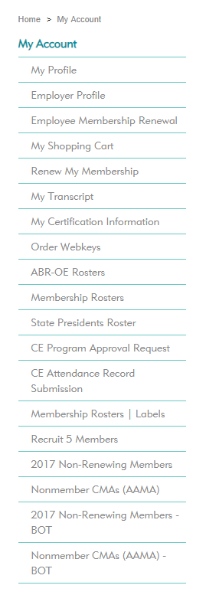
AAMA State/Chapter CMA (AAMA) Lists
Sign in and find member lists under the “My Account.”
Your role at the state or local level determines your access.
Access will be available to the following lists:
Membership Roster: Current members
Nonrenewing Members: Delinquent members
Nonmember CMAs (AAMA): CMAs (AAMA) who never joined or haven’t renewed
New CMAs (AAMA): Those who recently passed the CMA (AAMA) Exam (coming soon―by early 2019)

Slide 3
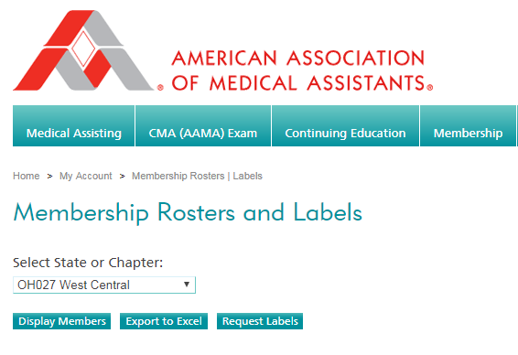
Use the lists to help increase your membership.
Market to existing members, as well as nonmember CMAs (AAMA).
Within these lists you can do any of the following:
Display a list of CMAs (AAMA).
Export to Excel.
You can then upload to mass email or print mailing labels.
Request a list in label format from the AAMA.

Slide 4
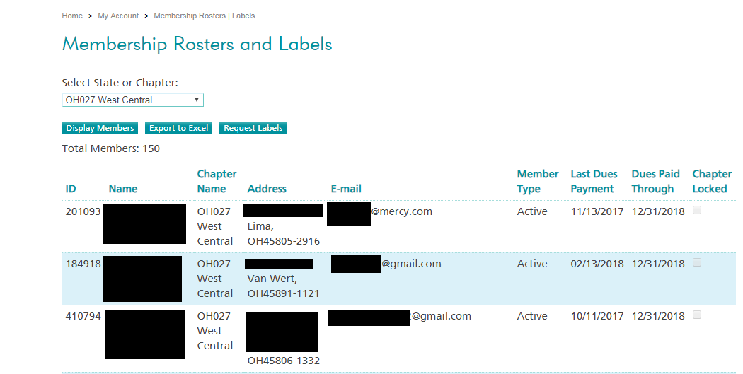
View name, address, and email. Easily identify when members last paid their dues and when their dues expire.

Slide 5
View the same information in Excel format with additional columns.
Sort columns by city, zip code, or another specification.

Slide 6
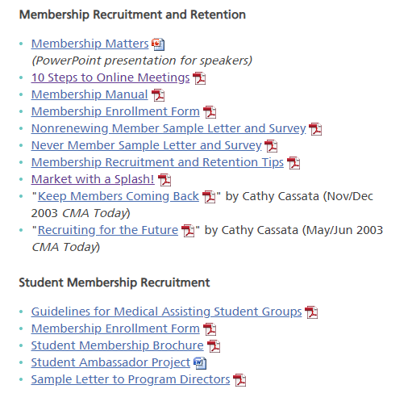
Resources
Find resources under the “Volunteers” menu item and “Marketer’s Center” dropdown tab.
See the “Membership Recruitment and Retention” section for documents that can be used in your recruitment and networking efforts.
Discover additional resources for students under “Student Membership Recruitment.”
Use these items to network with local medical assisting programs.

Slide 7
Recruit and Engage New and Young Members

Slide 8
Why are they not joining?
Three reasons young members don’t join:
Don’t know about the organization.
Don’t realize the organization is for them.
Don’t see the value in being a member.
Value trigger point
The point at which the member sees the value in being a member.
Determine what is that one benefit that attracts and brings the target population to the organization.
*Amanda Kaiser | Smooththepath.net

Slide 9
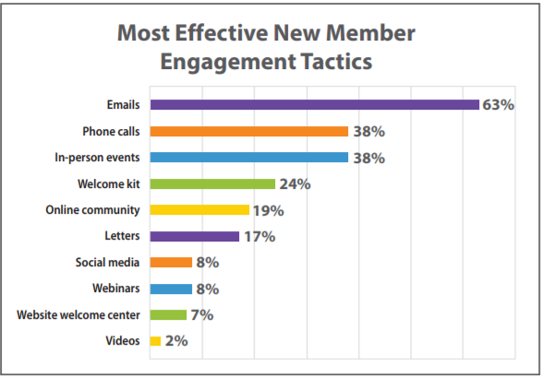
Reach out to members and nonmembers
Let them know you are there and our association is for them!
Use the member lists to reach out:
Emails
Personal phone calls
Letters/postcards
Social media
Smooththepath.net

Slide 10
Reach out, cont.
Utilize your membership committee to engage with the members/nonmembers to attend meetings/education.
Create a Welcome Committee – or have it be part of the Membership Committee
Welcome new members and help establish an immediate sense of belonging.
Ask newcomers where they work and what they do.
Introduce new members to a veteran member.
Observe new members throughout the event and work to enhance engagement.
Making that personal connection with them will help them to be engaged

Slide 11
Observe members
Observe members at events:
Are they there alone?
Are they interacting with others?
Are your members interacting with them?
What are their reactions to what is happening?
Put yourself in their shoes―what do you see?
How are the members treating them?
How would you feel if you were that member?
Use this information to determine what else you can do to recruit and retain your members.

Slide 12
Engage members
Make sure they feel welcomed and that they bring value to the organization.
Use a mentor/mentee program to help give them the resources to be successful in their career and future role within the organization.
Ensure that long-term members are welcoming and see the value in new and innovative ideas.
Have them volunteer and serve on committees―get them involved.

Slide 13
Engage student members
Get students involved.
Have a student representative on your BOT―have them get other students involved.
Offer a new member orientation program―explain:
Member benefits
How to recertify
How to renew membership.
Add a 10-minute session to each of your meetings to go over these items―don’t assume everyone knows.

Slide 14
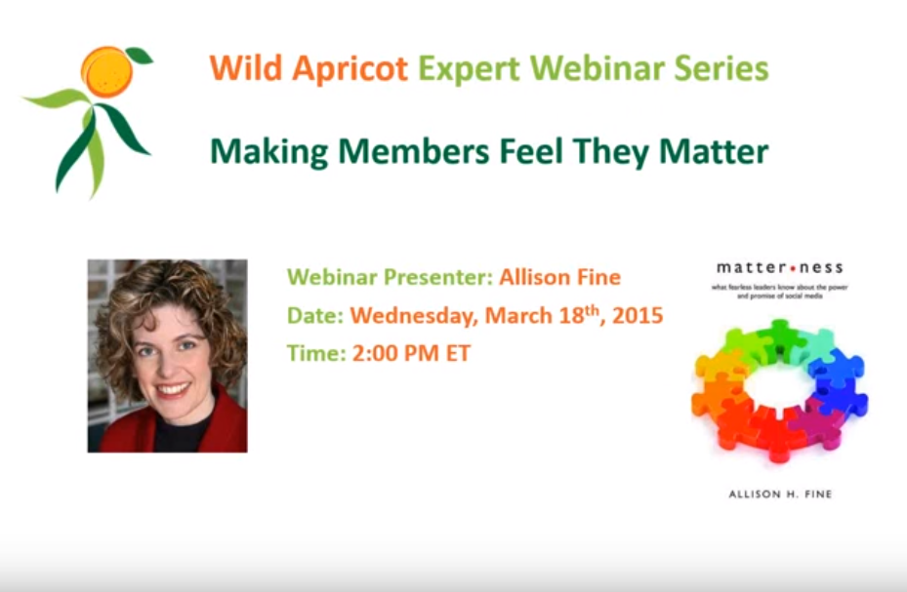
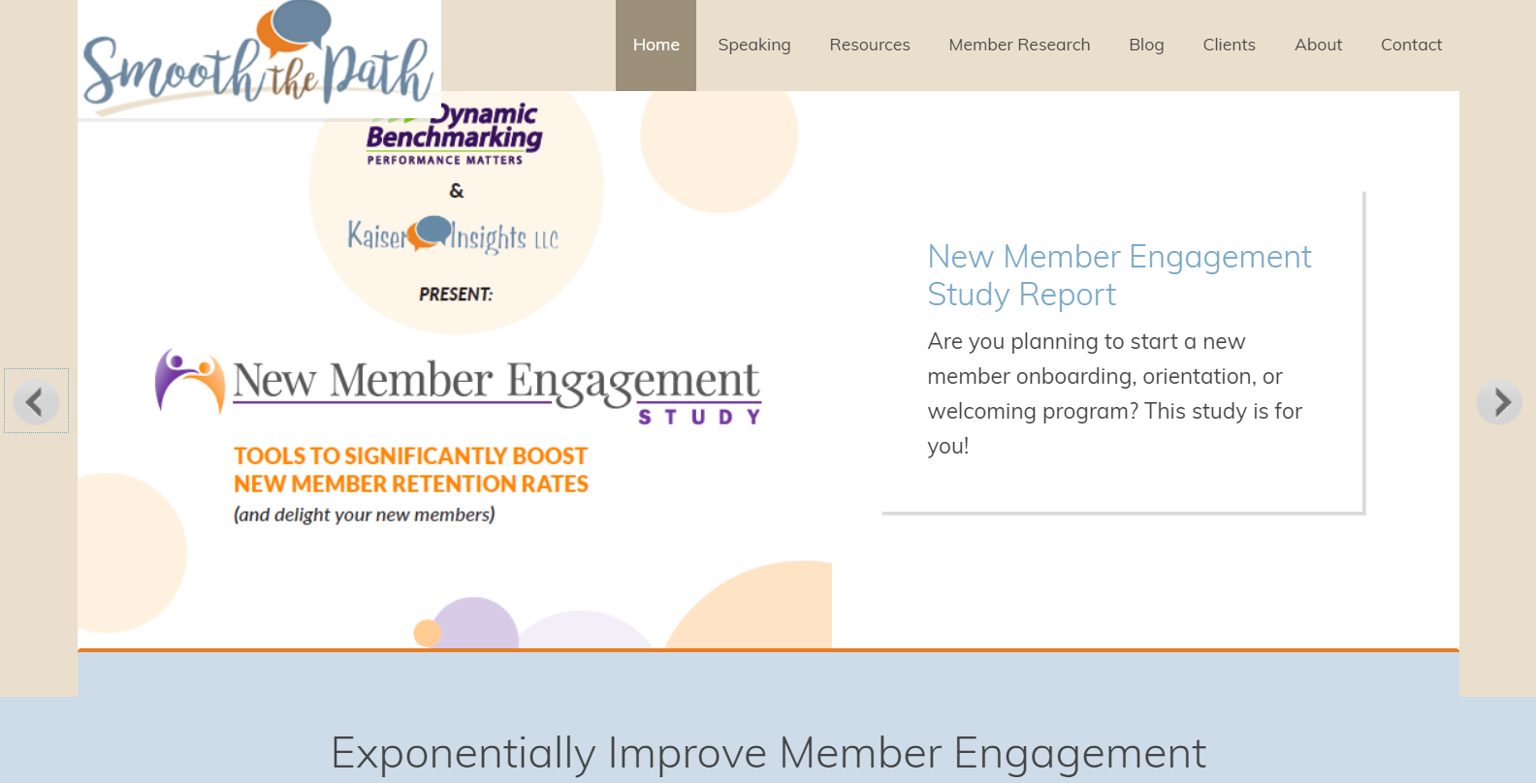
https://youtu.be/Kl6R92zxLic https://youtu.be/uZ6f_hfv_nw
Smooththepath.net

